Slide 1
Course : MOBI8001 – Mobile Technology and Cloud Computing
Mobile Computing
Session 01
D5727- Dr. Eng. Nico Surantha, ST., MT.

Slide 2
Reference
[1] DE, Debashis. Mobile cloud computing:architectures, algorithms and applications. CRC Press, 2016.
[2] R. Kamal, Mobile Computing, Oxford University Press, Inc., Oxford, U.K., 2008.
[3] T. S. Rappaport, Wireless Communications: Principles and Practice, vol. 2, Prentice Hall PTR, Upper Saddle River, NJ, 1996.
[4] L. S. Ashiho, Mobile technology: Evolution from 1G to 4G, Electronics for You, 94–98, 2003.

Slide 3
Outline
Introduction
Architecture of Mobile Network
Generations of Mobile Communications
Applications of Mobile Communication
Challenges of Mobile Communication
Bina Nusantara University

Slide 4
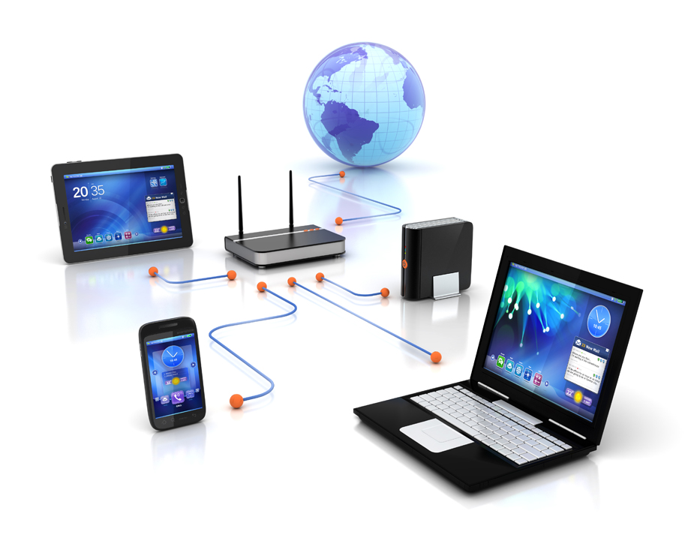
Introduction
3 aspects of Mobile Computing:
Mobile devices
Mobile communication
Mobile application
Ref: http://www.urbannewsdigest.in/?p=2017

Slide 5










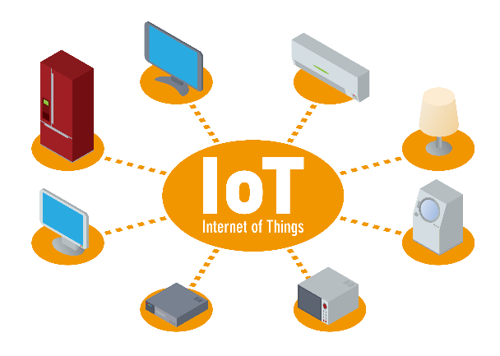

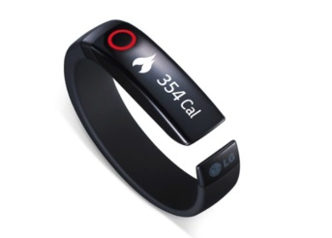


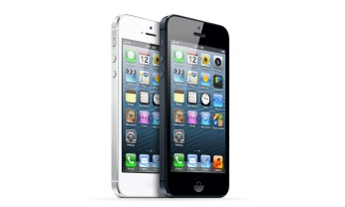
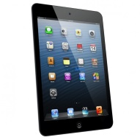
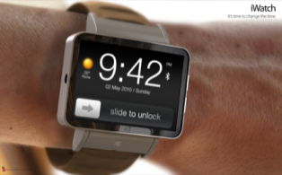
Introduction (2)
1990
2000
2010
2020
The Evolution of Digital Technology

Slide 6
Introduction
Key technical issues
  Mobile architectures
  Mobile support services
  Algorithm for mobile network design
  Protocol design and analysis
  Mobile environments
  Mobile communication systems
  Applications
  Emerging mobile technologies
  Pervasive and mobile computing
Bina Nusantara University
Notes:
Mobile architectures: mobile network; standardization
Mobile support services: OS support, green mobile computing, power/energy management
Algorithm for mobile-network design:
Mobile communication systems: data encoding and compression, spread spectrum technologies, multiuser access
Applications: wearable computers and body area networks
Emerging mobile technologies: opportunistic computing, internet-of-things

Slide 7
Architecture of Mobile Network
Mobile networks can be classified into three different categories:
  Cellular networks
  Mobile ad hoc networks
  Mobile wireless sensor network
Bina Nusantara University

Slide 8
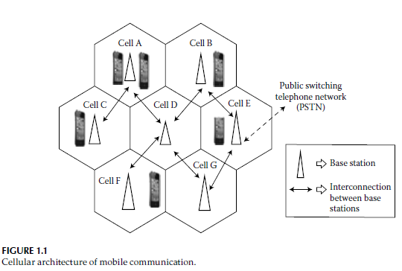








Architecture of Cellular Network
Area is divided into several cell with low-power base station in the center
Using frequency reuse concept
Frequency reuse distance formula
  Note:
    r=distance between cell center and cell boundary
    N = number of adjacent cell
Frequency reuse = non-adjacent cell can reuse frequency
Bina Nusantara University
Notes:
The architecture of early mobile systems was intended to realize a huge coverage area using a single transmitter operating with high-power consumption and mounted on an elevated tower

Slide 9
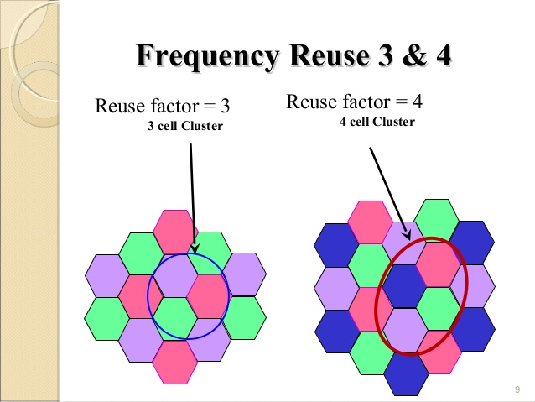
Architecture of Cellular Network (2)
Frequency reuse = non-adjacent cell can reuse frequency
Bina Nusantara University
Notes:
The architecture of early mobile systems was intended to realize a huge coverage area using a single transmitter operating with high-power consumption and mounted on an elevated tower

Slide 10
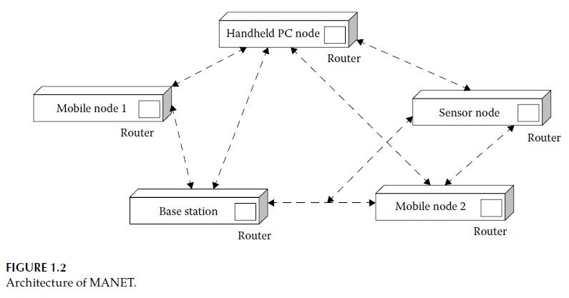
Architecture of Mobile Ad Hoc Network
Infrastructureless network
Self-organizing network
Architecture is not static and may change with the movement of the nodes
Notes:
Each of these nodes behaves like a router and routes messages among the connected devices.
In MANET, the organization is dependent on the position of nodes, connectivity among them, and their ability to locate service and send or
receive messages to and from neighboring or peer nodes.

Slide 11
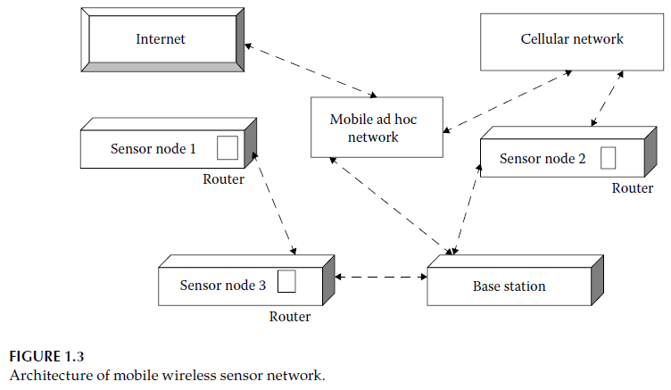
Architecture of Mobile Wireless Sensor Network
It is a MANET compose of sensor nodes with computational and communication abilities
Can be applied for health monitoring, tracking animal movement

Slide 12
Generations of Mobile Communications
1G Mobile Communication
2G Mobile Communication
2.5G Mobile Communication
3G Mobile Communication
4G Mobile Communication
5G Mobile Communication

Slide 13
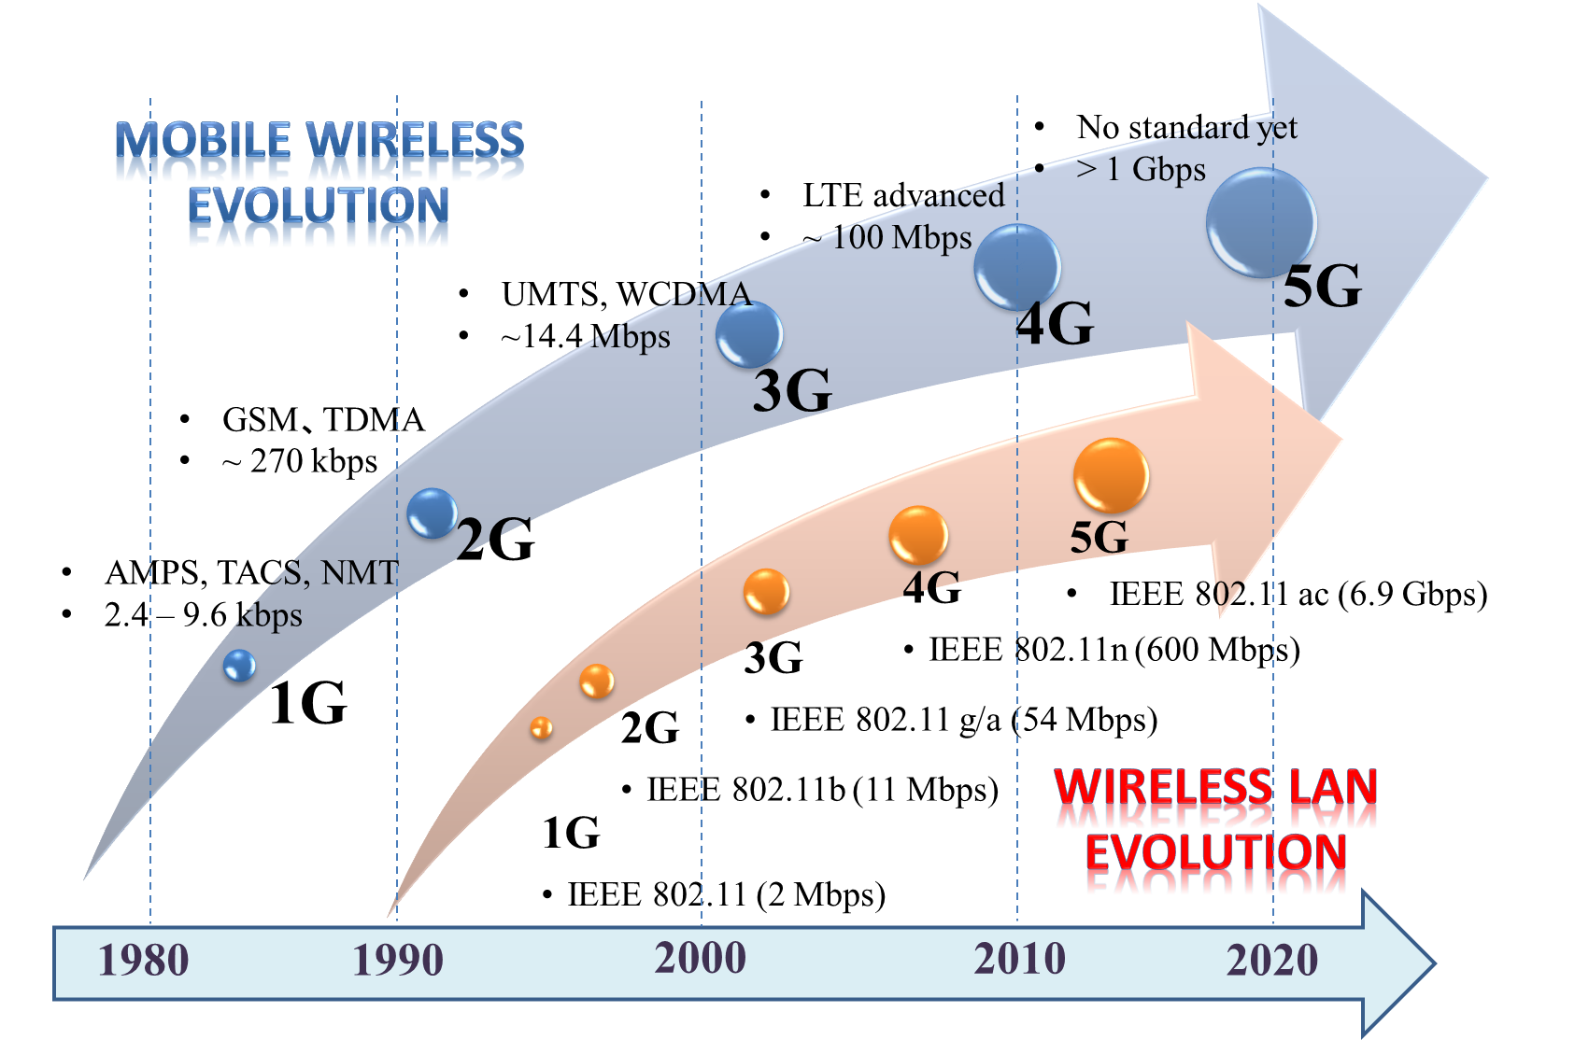
Generations of Mobile Communications (2)
Ref; Nico Surantha, et al, “System-on-chip Design with HW/SW Co-Design Methodology for Wireless Communication System, “ IEEE ISCIT 2017

Slide 14
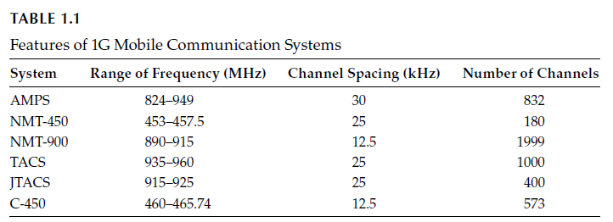
1G Mobile Communication
Developed during 1970-1980
Employ Frequency Division Multiple Access (FDMA)
Employ analog radio system
Small traffic capacity and 2.4 kbps speed
Vulnarable to security attacks
Unavailable roaming facilities

Slide 15
2G Mobile Communication
Developed during 1990
Global System for Communication (GSM) is the basis for 2G
Use digital modulation
GSM provides roaming and SMS
GSM standards operates in three bands: 900, 1800, and 1900 MHz
The transmission rate is 270 kbps

Slide 16
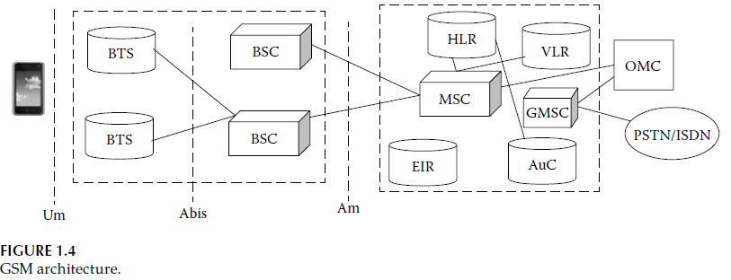
2G Mobile Communication

Slide 17
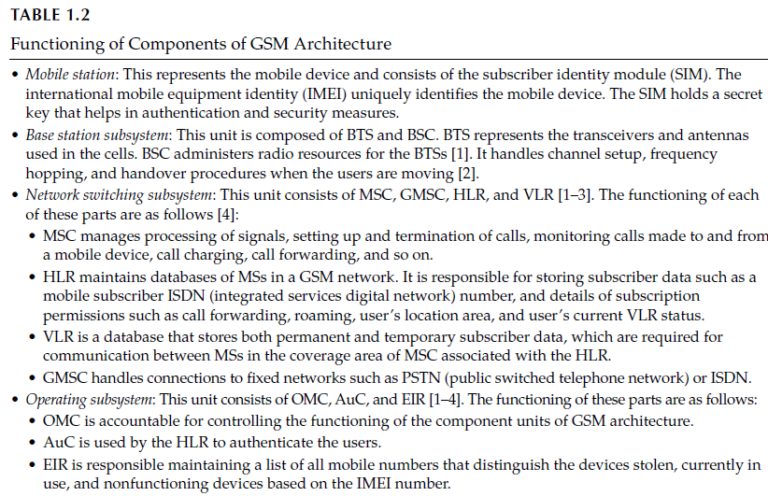
2G Mobile Communication

Slide 18
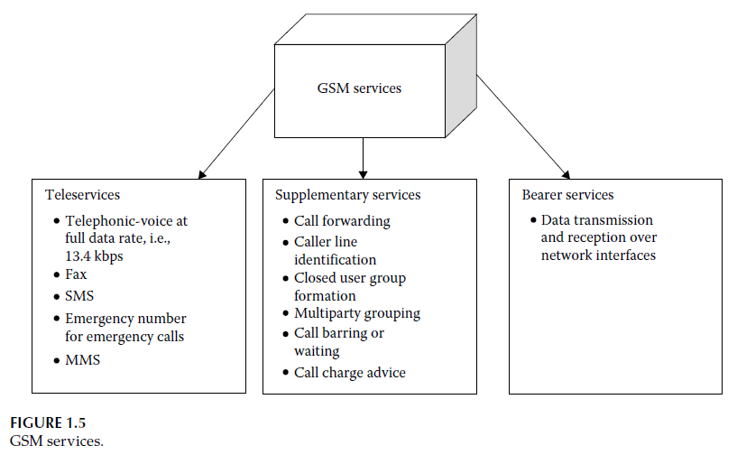
2G Mobile Communication

Slide 19
2.5G Mobile Communication
It was developed in 1995
Standard: General Packet Radio Services (GPRS)
Data rate 171-384 kbps
It allows users to make voice calls and data transmission simultaneously
First mobile internet

Slide 20
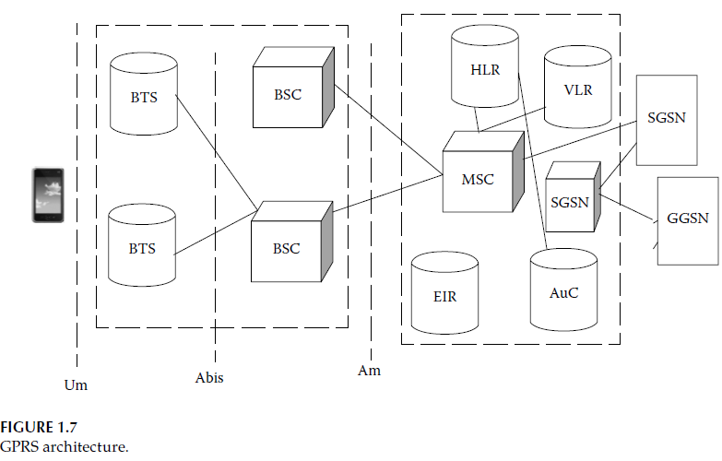
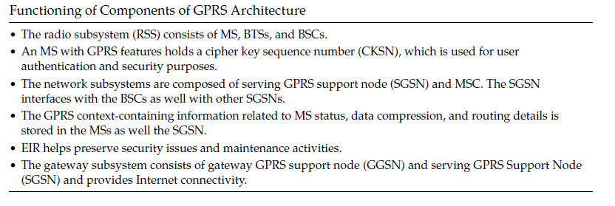
2.5G Mobile Communication (2)
Notes:
The Serving GPRS Support Node (SGSN) is a main component of the GPRS network, which handles all packet switched data within the network, e.g. the mobility management and authentication of the users. The SGSN performs the same functions as the MSC for voice traffic.

Slide 21
3G Mobile Communication
Developed in 1997
Supports data rates of over 2-5 Mbps
Provide better quality experience for the users. And support multimeda data transfer, such as transfer audio, video, text, pictures.
Standard: WCDMA (1997), CDMA2000(2000)

Slide 22
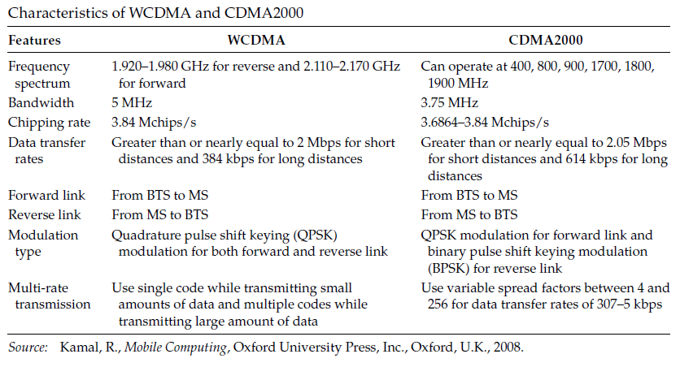
3G Mobile Communication

Slide 23
4G Mobile Communication
It was deployed during 2010-2012
It supports high-speed multimedia data transfer, high-definition television (HDTV) content, and high-speed internet access
Standard: WiMAX, LTE
Data rate : 10-20 Mbps

Slide 24
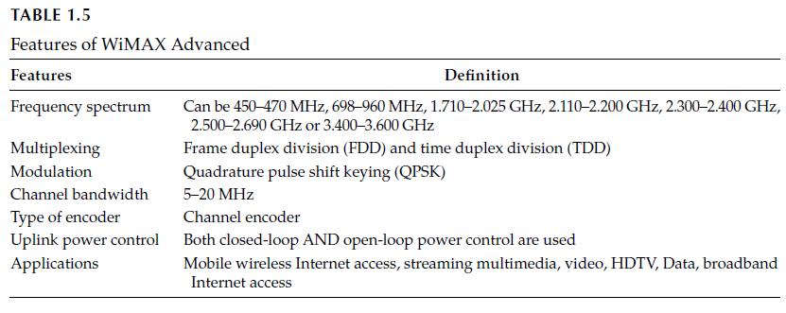
WiMAX Features

Slide 25
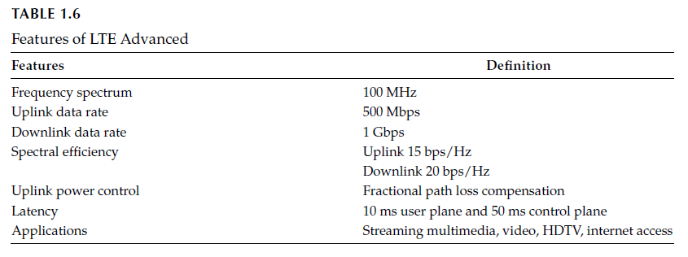
LTE Advanced Features

Slide 26
5G Mobile Communication
It will be introduced around 2020
Data rate > 1 Gbps
All IP-based system
Applied for mobile portals, mobile commerce, mobile health care, etc
The employment of cloud computing will be crucial for 5G mobile communication
Cloud computing facilitates user to get their data stored and applications run in a distand cloud server

Slide 27
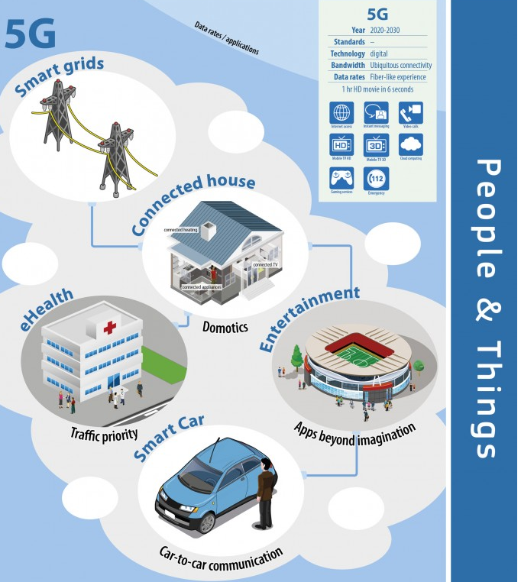
5G Mobile Comunications

Slide 28
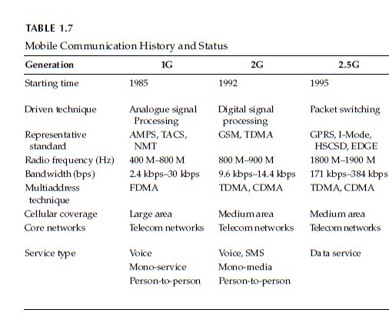
Summary of Mobile Generations

Slide 29
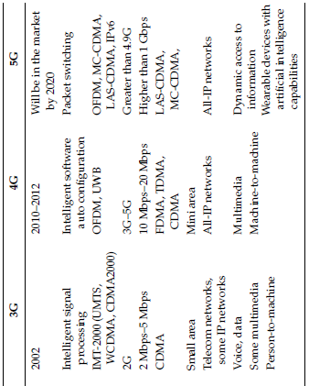
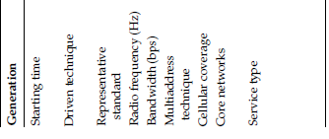
Summary of Mobile Generations

Slide 30
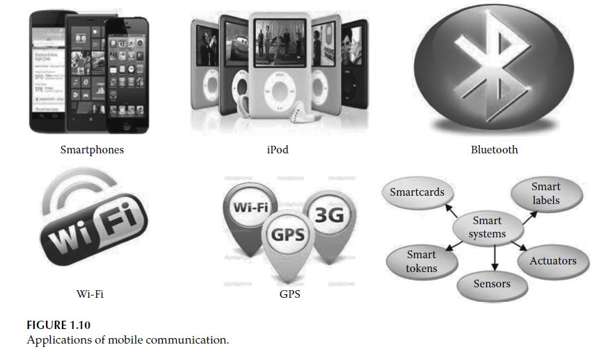
Applications of Mobile Computing
Notes:
Smart card: atm, e ktp
Smart labels : barcode

Slide 31
Challenges of Mobile Communications
Wireless communication
Mobility
Resource limitation
Mobile channel models
Disaster management
Mobile data mining
Quality of service

Slide 32
Wireless communication challenges
Disconnection
Low bandwidth
Network optimization for Confined Areas with High User Concentration
Variable Network Conditions
Security Issues
Notes:
Wireless networks provide lower bandwidths compared to wired networks.

Slide 33
Mobility challenges
Changing network address
Locality migration
Locality management
Mobile network traffic forecasting
Mobile call admission control and handover management

Slide 34
Resource Limitation
Data storage
  Memory of mobile devices is finite
  The storage offloading to cloud server is one of the solution
Power consumptions
  Mobile devices rely only on battery
  The computation offloading technique to resource rich cloud server is one of the solution

Slide 35
Mobile channel model
  It is important for design, evaluation, and testing of mobile systems
More sophisticated channel models could help operators optimize base station deployment optimize base station deployment and periodically tune base stations’ transmission patterns, which would allow them to increase the usable capacity those stations

Slide 36
Disaster Management
Because of the sudden occurrence of a natural disaster or an accident, the number of users in a cell within that devastated area increases rapidly. Therefore, the number of call arrivals and call generations increases suddenly in that confined area.

Slide 37
Mobile Data Mining
Highly developed data mining could provide a means for better understanding mobile users, enabling mobile operators and other mobile service providers to provide services tailored to specific customer segments and ultimately to individual users.
Such efforts could stimulate greater user spending and increase customer satisfaction, thus decreasing customer defection

Slide 38
Quality of Service
The growth of mobile data applications is expected to hurt the capacity of mobile networks and could degrade the quality of experience during periods of peak demand.
New QoS measurement tools will help service providers, such as mobile telephone vendors, to better measure and monitor users’ experience with various applications, including voice calls, SMS, email, web browsing, video clips, streaming video, and GPS.

Slide 39
Conclusion
Mobile communication is one of the primary areas of science and technology that has been focusing on the way information exchanges between individuals and organizations via mobile devices.
The evolution of mobile communication replaced the usage of telegrams and letters with mobile phones and emails.
Mobile communication has recently become the spine of civilization. The technology of mobile communications has improved the art of living and made lives easier. But it comes with certain challenges.
In this chapter, we presented a discussion on the details of mobile communication such as the architecture of mobile communication, the evolution of mobile communication from 1G to 5G, different operating systems supporting mobile communication, and the applications of mobile communications, and highlighted a few challenges of mobile communication.

